Slide 1
Vision Transformer Models
Mohammad Ahmad Khattab Mousa
ID 2002639

Slide 2
Abstract
Transformer model are the dominant models for NLP tasks but still CNN models are the dominant models for computer vision tasks.
The authors propose to use vision transformer for image classification tasks.
Achievements: The model achieves accuracy better than CNN models for reference bench marks.
Drawbacks: The model requires a huge pre-training dataset.

Slide 3
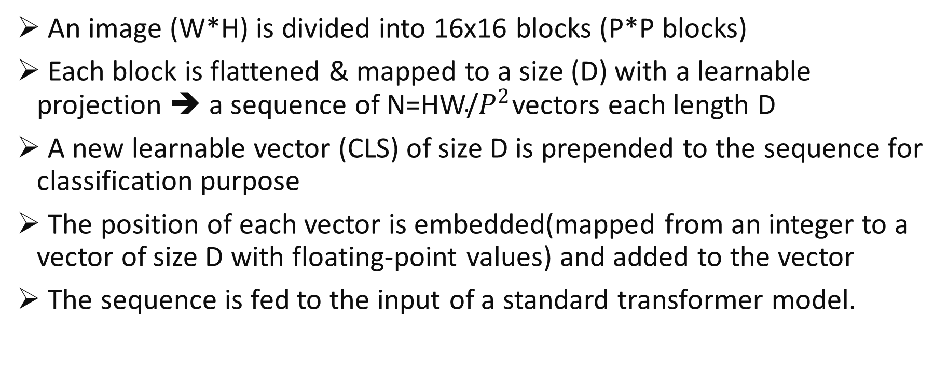
Architecture
An image (W*H) is divided into 16x16 blocks (P*P blocks)
Each block is flattened & mapped to a size (D) with a learnable projection ➔ a sequence of ${\text{N}\text{=}\text{HW}\text{/}P}^{2}$vectors each length D
A new learnable vector (CLS) of size D is prepended to the sequence for classification purpose
The position of each vector is embedded(mapped from an integer to a vector of size D with floating-point values) and added to the vector
The sequence is fed to the input of a standard transformer model.

Slide 4
Architecture

Slide 5
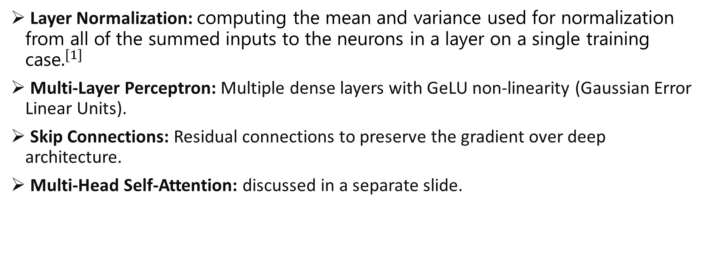
Transformer Block
Layer Normalization: computing the mean and variance used for normalization from all of the summed inputs to the neurons in a layer on a single training case$.^{[1]}$
Multi-Layer Perceptron: Multiple dense layers with GeLU non-linearity (Gaussian Error Linear Units).
Skip Connections: Residual connections to preserve the gradient over deep architecture.
Multi-Head Self-Attention: discussed in a separate slide.

Slide 6
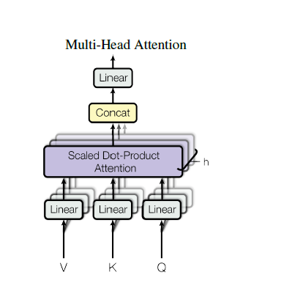
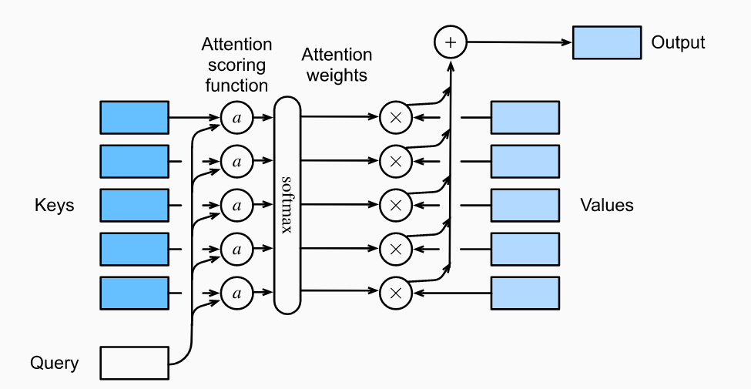
Multi-Head Self-Attention
Multi-Head Self-Attention:
Linearly project the input to (h) sets of (Queries, Keys and Values) through a different, learnable projection.
Over each set, perform attention on parallel
concatenate the output from (h) different attention networks.
Finally project the output to the original dimension.

Slide 7
Experiment
ViT Models
Model | Layers | D (Latent Vector Size) | MLP size | Heads | Params
ViT-Base | 12 | 768 | 3072 | 12 | 86M
ViT-Large | 24 | 1024 | 4096 | 16 | 307M
ViT-Huge | 32 | 1280 | 5120 | 16 | 632M
Pre-training Datasets
Dataset | Number of Classes | Number of Images
ImageNet | 1k classes | 1.3M images
ImageNet-21k | 21k classes | 14M images
JFT-300 | 18k classes | 303M high-resolution images.

Slide 8
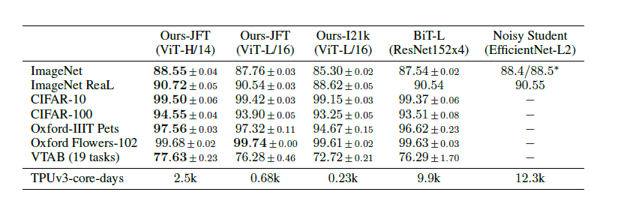
Results
Notes:
ResNet was pre-trained over JFT dataset
EfficientNet was pre-trained using semi-supervised learning on ImageNet and JFT-300M with the labels removed
Comments:
ViT models requires pre-training over large datasets or otherwise will show lower accuracy due to missing inductive biases inherited in CNN architecture
ViT models showed low computation requirements compared to CNN
ViT-H model outperforms CNN models
Results for training directly over the data is not presented
EfficientNet results are not complete

Slide 9
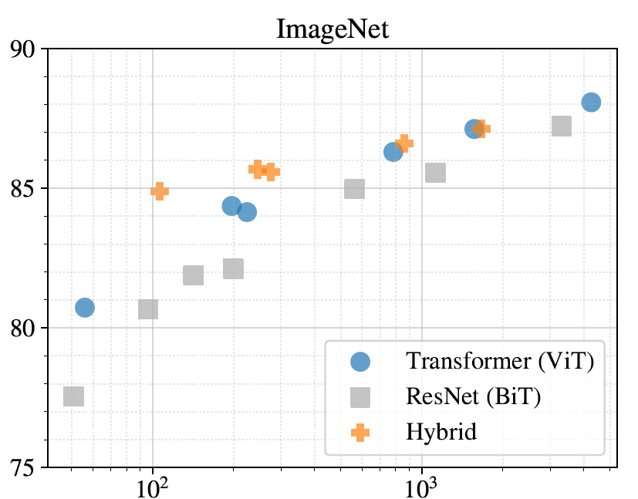

Results
Comments:
For the same pre-training computation, CNN shows lower accuracy compared ViT and hybrid model (using CNN to generate the image patches).
For low pre-training computation, hybrid models do better than ViT due to inductive biases inherited in CNN layers.
For high pre-training computation, ViT and hybrid models are very close to each other as ViT learns directly from the large data

Slide 10
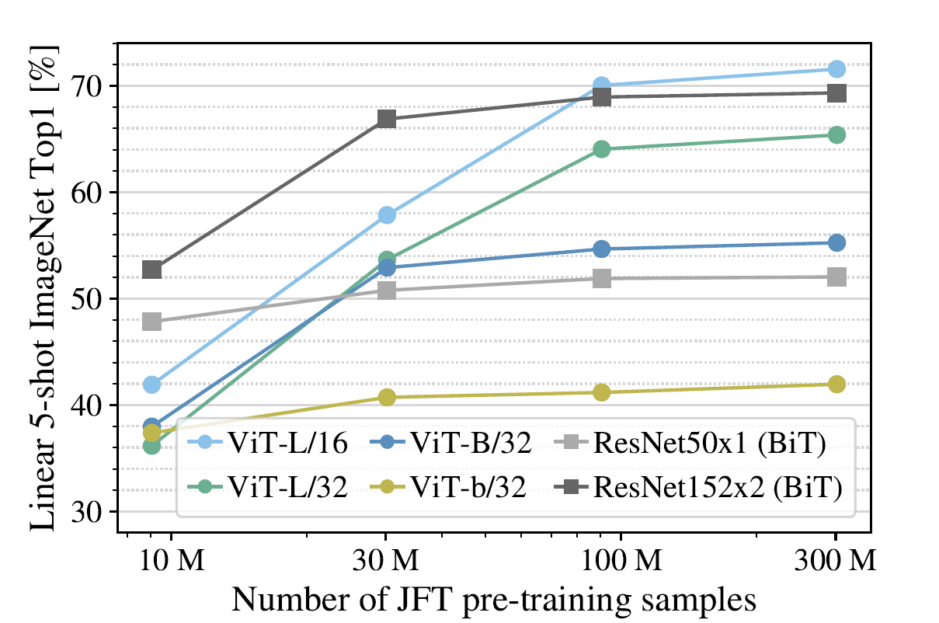
Results
Comments:
All models showed accuracy improvements while adding more pre-training samples
Improvement is more obvious over large models

Slide 11
Conclusion
Vision transformers lack many of the inductive biases found in CNN networks.
Vision transformer showed accuracy enhancement compared to CNN models when pre-trained over huge datasets.
Training directly over the target dataset showed low accuracy.

Slide 12
Thank You

